Slide 1

Topic Name : Multithreading ( iii )
Submitted By :
Abu Ubaida Sayeb
Md Mofazzal Hossain
Md Dulal Hossain
Submitted To :
Dr. Muhammad Aminur Rahaman
Assistant Professor and Campus Director,
Permanent Campus.
213902113
213902114
213902116
Green University
Department of Computer Science and Engineering

Slide 2
OUTLINES
Synchronized Methods
Synchronized Statement
Inter-Thread Communication
Suspending, Resuming, and Stopping Threads
Modern way of Suspending, Resuming, and Stopping Threads
Using of Multithreading

Slide 3


SYNCHRONIZATION

Slide 4
PURPOSE OF SYNCHRONIZATION
Output Without Synchronization
Thread 1
Thread 1
Thread 2
Thread 2
Thread 1
Thread 2
Output Without Synchronization
Thread 1
Thread 1
Thread 1
Thread 2
Thread 2
Thread 2

Slide 5
CATEGORIES OF SYNCHRONIZATION
01
02
Method
Level
Synchronization
Block
Level
Synchronization

Slide 6
LIVE EXAMPLE OF SYNCHRONIZATION
Continue…
Sunchronized Area
One Thread Enters
Others are waiting outside

Slide 7

LIVE EXAMPLE OF SYNCHRONIZATION
Continue…
5000 Taka
5000 Taka\-
Withdraw
Before Synchronization

Slide 8
LIVE EXAMPLE OF SYNCHRONIZATION
5000 Taka
Insufficient Balance
5000 Taka\-
Withdraw
After Synchronization

Slide 9
METHOD LEVEL SYNCHRONIZATION
Public void run()
{
//Same Resource
}
T1.start(); //accessed
T2.start(); //accessed
T3.start(); //accessed
Public synchronized void run()
{
//Same Resource
}
T1.start(); //accessed
T2.start();//Waiting
T3.start();//Waiting

Slide 10
BLOCK LEVEL SYNCHRONIZATION
Continue…
Home
School

Slide 11
BLOCK LEVEL SYNCHRONIZATION
class msg { public void show(String name) {//HOME ;;;;; // 100 Line Code synchronized (this) { for (int i = 1; i <= 3; i++) { System.out.println("HOW ARE YOU" + name); } ;;;;; // 100 Line Code } //SCHOOL } }

Slide 12
class OurThread extends Thread { msg m; String name; OurThread(msg m,String name) { this.m = m; this.name = name; } public void run() { m.show(name); } }

Slide 13
class SyncBlock { public static void main(String[] args) { msg m = new msg(); OurThread t1 = new OurThread(m,"Sayeb"); OurThread t2 = new OurThread(m,"Jubaer"); t1.start(); t2.start(); } }

Slide 14
OUTPUT
HOW ARE YOUSayeb
HOW ARE YOUSayeb
HOW ARE YOUSayeb
HOW ARE YOUJubaer
HOW ARE YOUJubaer
HOW ARE YOUJubaer
Process finished with exit code 0

Slide 15
INTER-THREAD COMMUNICATION
A mechanism in which a thread is paused running in its critical section and another thread is allowed to enter in the same critical section to be executed
It is also known as Cooperation in java
Three methods :
wait()
notify()
notifyAll()

Slide 16



POLLING
What is polling?
The process of testing a condition repeatedly till it becomes true is known as polling
Wastes many CPU cycles
Makes the implementation inefficient
Market Status : Available

Slide 17
IMPLEMENT INTER-THREAD COMMUNICATION
public class BikeShopApp{
public static void main(String[] args) {
Bike b = new Bike();
b.start();
System.out.println(b.available);
}
}
class Bike extends Thread{
boolean available = false;
@Override
public void run()
{
available = true;
}
}
Output (Terminal):
false
BUILD SUCCESSFUL.
l

Slide 18
IMPLEMENT INTER-THREAD COMMUNICATION
class Bike extends Thread{
boolean available = false;
@Override
public void run()
{
available = true;
}
}
public class BikeShopApp{
public static void main(String[] args) {
Bike b = new Bike();
b.start();
System.out.println(b.available);
}
}
Thread Main
Thread 0
OUTPUT: false

Slide 19
IMPLEMENT INTER-THREAD COMMUNICATION
class Bike extends Thread{
boolean available = false;
@Override
public void run()
{
synchronized(this)
{
available = true;
this.notify();
}
}
}
public class BikeShopApp throws InterruptedException {
public static void main(String[] args) {
Bike b = new Bike();
b.start();
synchronized(b)
{
b.wait();
}
System.out.println(b.available);
}
}
Output (Terminal):
true
BUILD SUCCESSFUL.

Slide 20

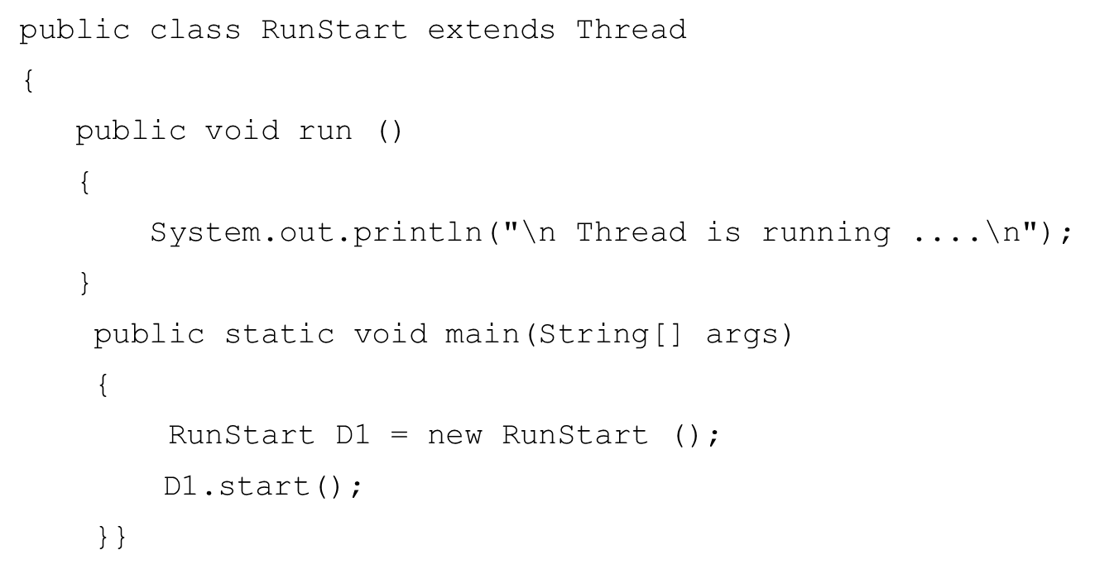
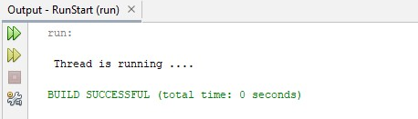
RUN & START METHOD

Slide 21
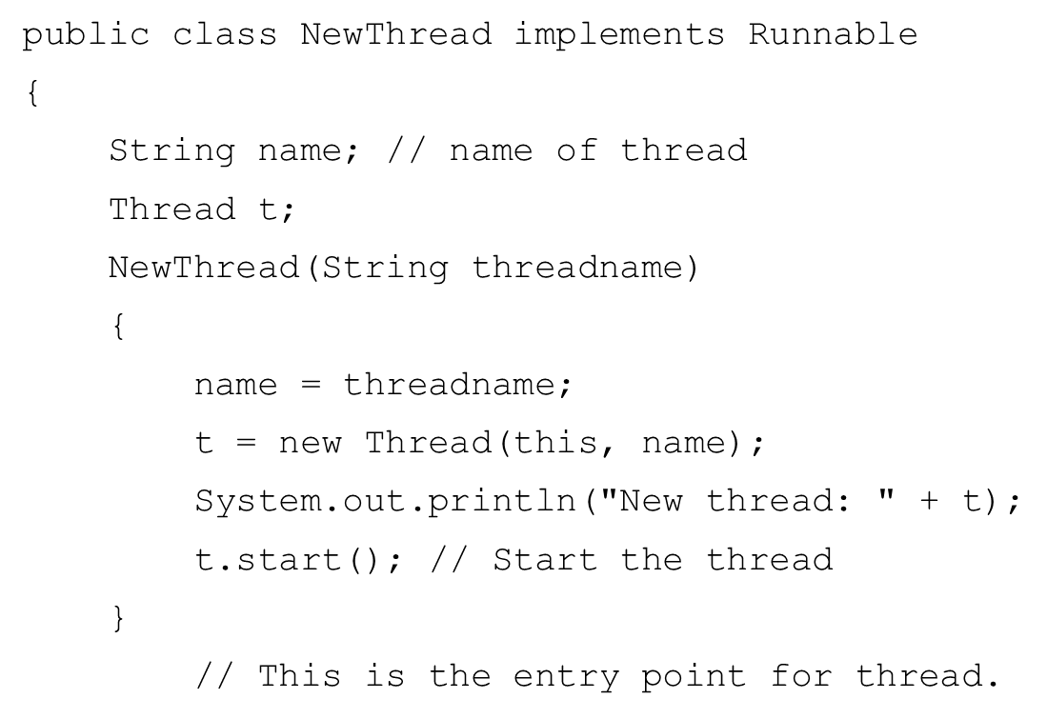
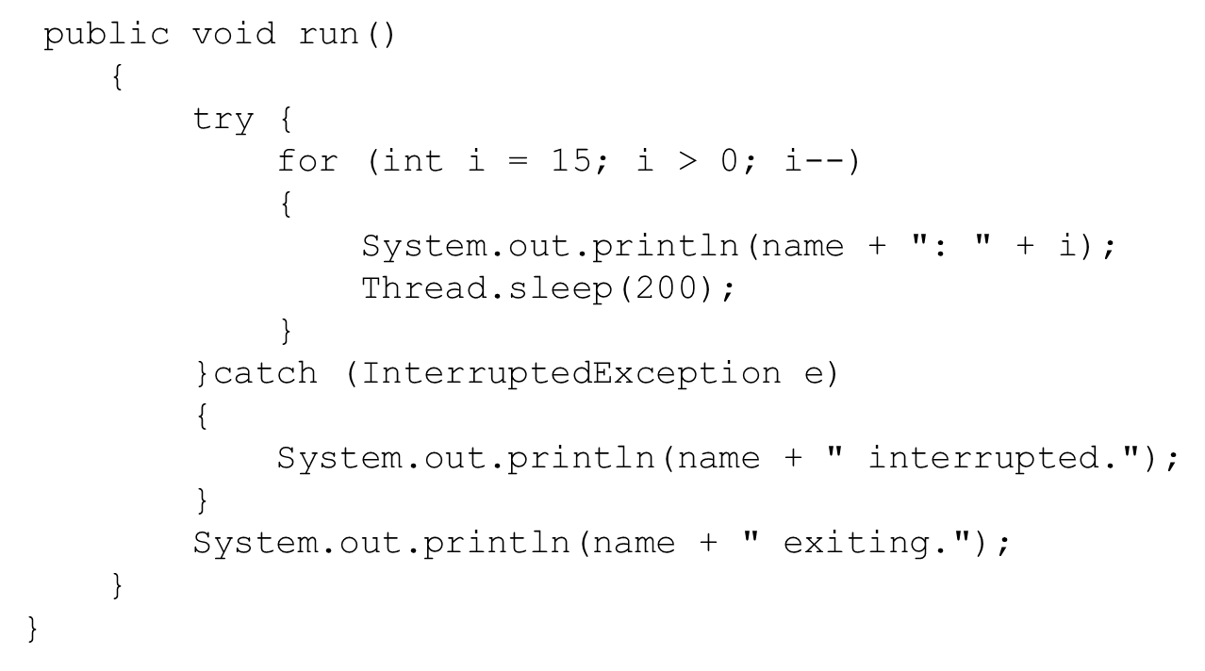
SUSPENDING & RESUMING METHOD

Slide 22
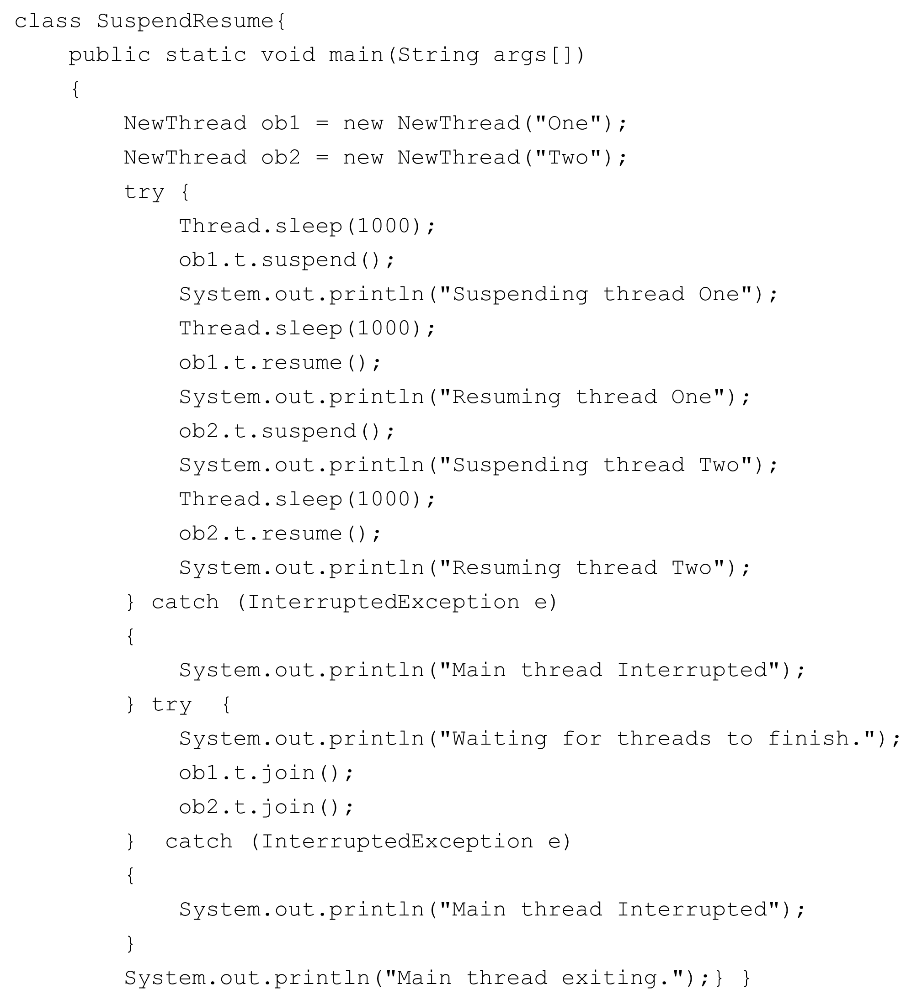
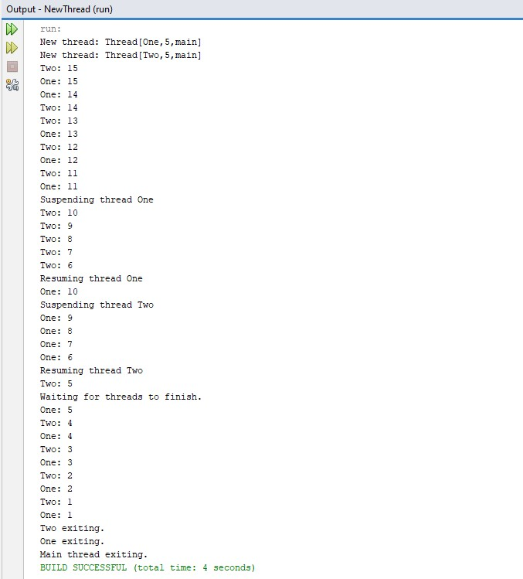
SUSPENDING & RESUMING METHOD

Slide 23
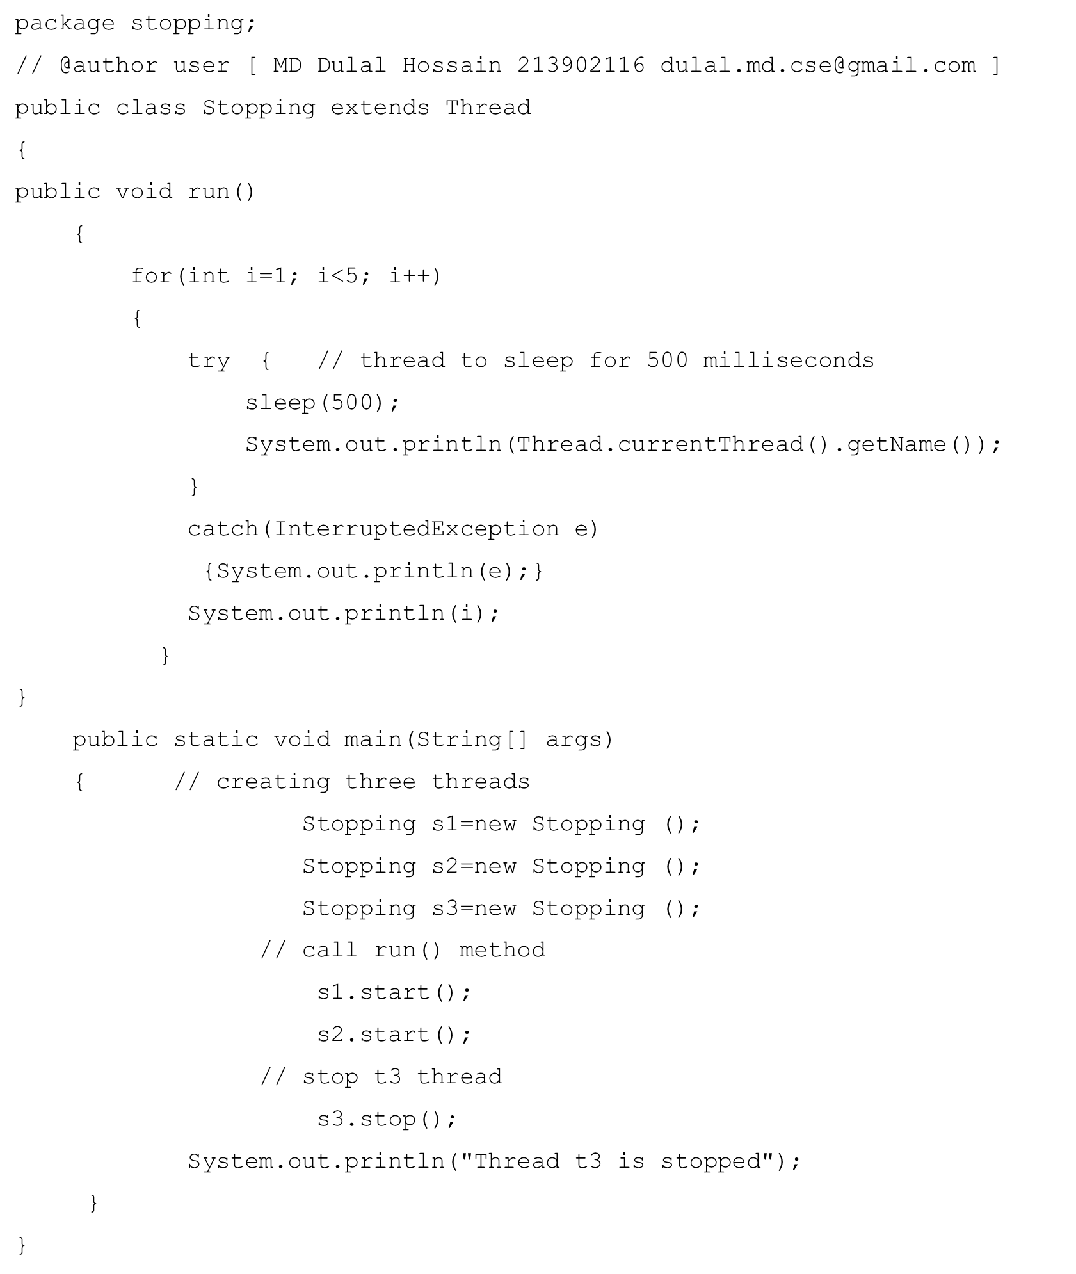
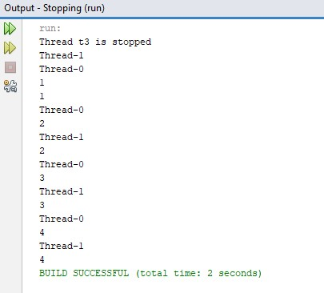

STOPING METHOD

Slide 24
USING MULTITHREADING
The key to utilizing Java’s multithreading features effectively is to think concurrently rather than serially. For example, when you have two subsystems within a program that can execute concurrently, make them individual threads. With the careful use of multithreading, you can create very efficient programs. A word of caution is in order, however: If you create too many threads, you can actually degrade the performance of your program rather than enhance it. Remember, some overhead is associated with context switching. If you create too many threads, more CPU time will be spent changing contexts than executing your program.

Slide 25
Thank You
Keep Learning, Keep Grinding

